Slide 1
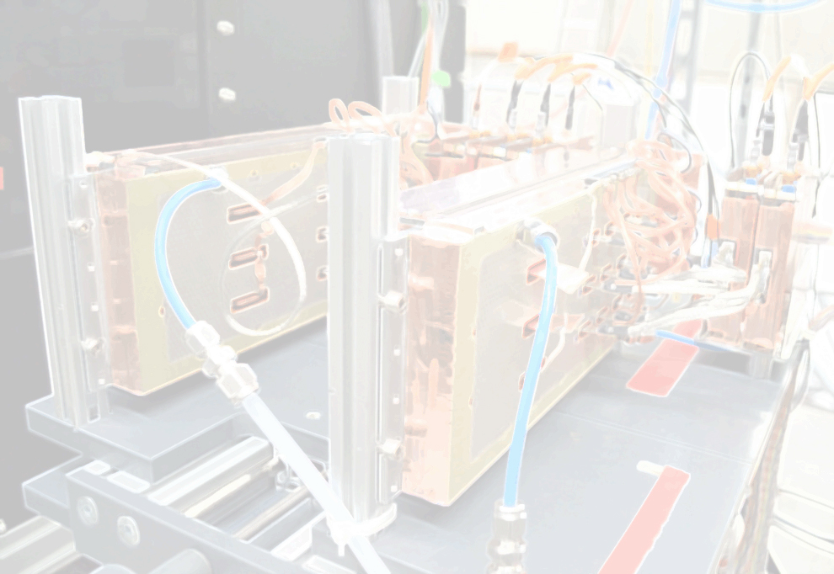

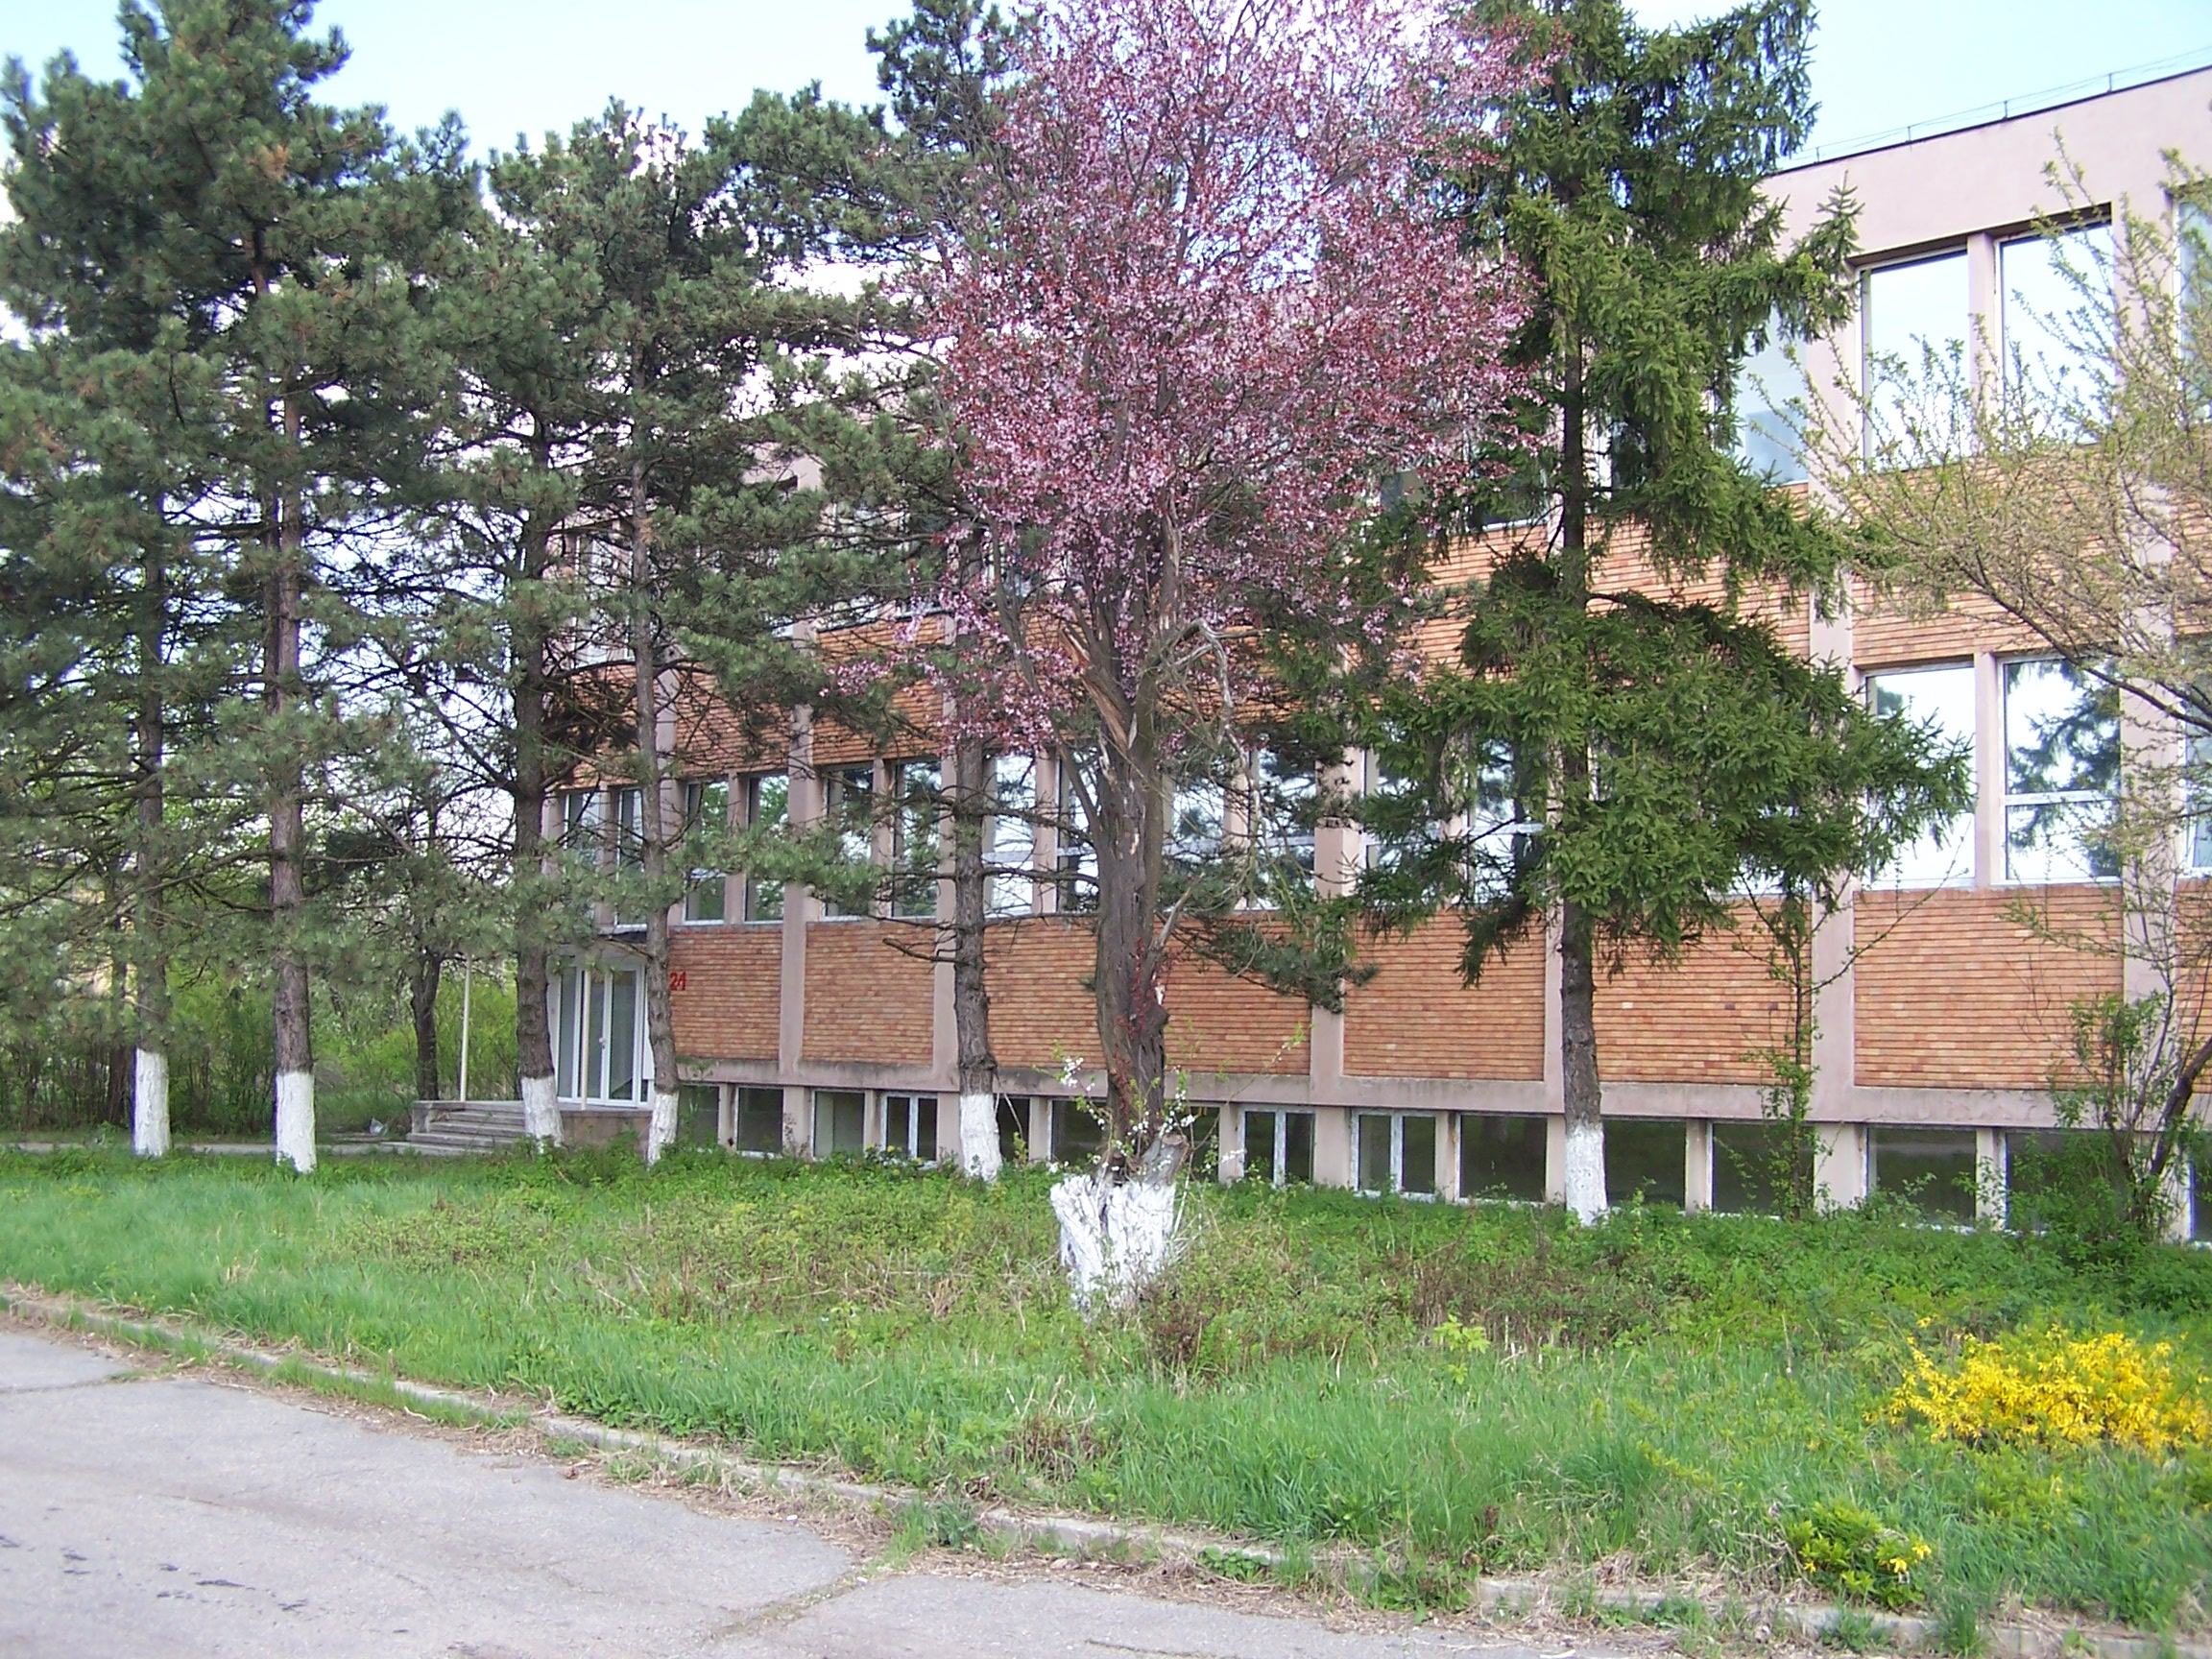


e/π identification and position resolution of high granularity single sided TRD prototype
2nd European Nuclear Physics Conference, 17-21 September 2012 Bucharest, Romania
M. Târzilă, V. Aprodu, D. Bartoş, A. Bercuci, V. Cătănescu, F. Constantin, G. Caragheorgheopol, M. Petriş, M. Petrovici, L. Prodan, A. Radu, L.Rădulescu, V. Simion, P. Zaharia
  Compressed Baryonic Matter (CBM) experiment – Transition Radiation Detector (TRD) requirements and prototype design
  Pulse height distribution for electrons and pions @ different momenta
  e/π discrimination performance
  Position reconstruction. Systematic study
  Conclusions & Outlook
Hadron Physics Department
NIPNE-Bucharest
(NIHAM)

Slide 2

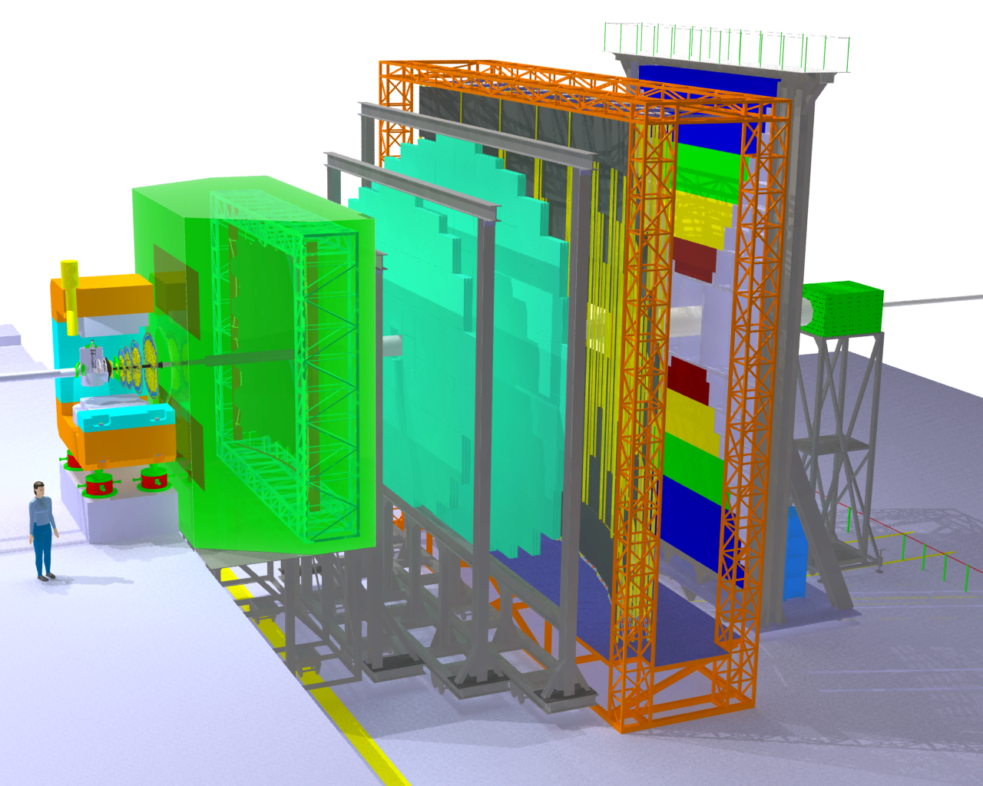
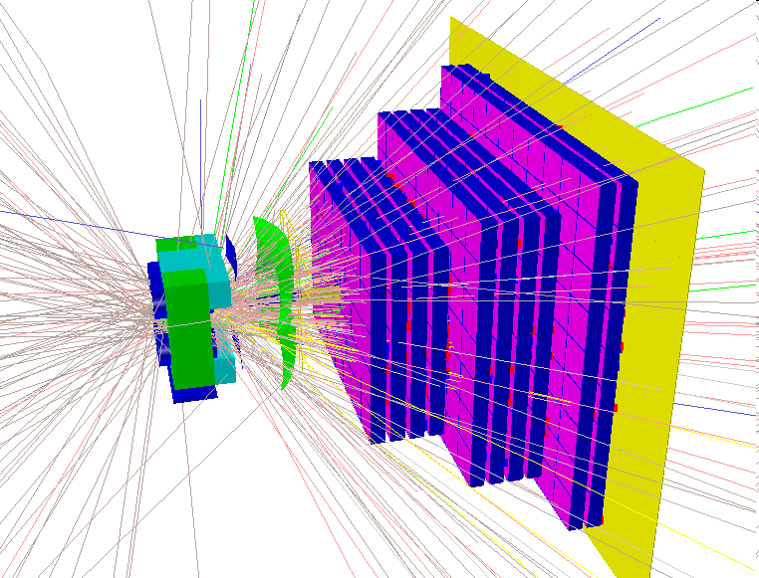
CBM - TRD requirements
2
  TOF
  Time
  of
  Flight
Tracking of all charged particles: position resolution ~ 200-300 μm @ high rates (10⁵ part/cm·sec) and high multiplicities
Identification of high energy electrons (γ>2000) with a pion rejection factor > 100 @ 90% electron efficiency
Geometry: 3 stations (3 layers each) positioned @ 4.5, 7.45 and 9 m from target
  ECAL
  Electromagnetic
  Calorimeter
  RICH
  Ring
  Imaging
  Cherenkov
  Detector
  TRD
  Transition
  Radiation
  Detector
  MVD+STS
Current TRD design:
  584 m² total area
  708 chambers
  737408 readout channels
Mădălina Târzilă, 2nd EuNPC, 20th September 2012
Current TRD structure

Slide 3
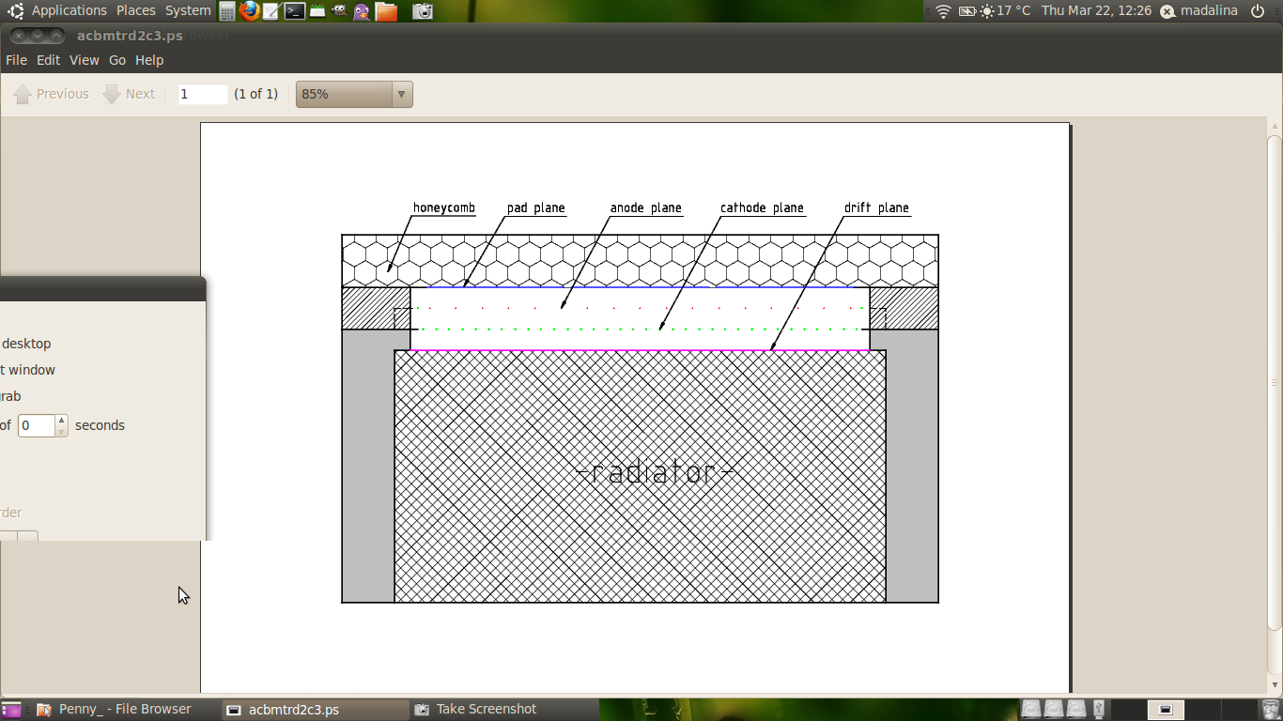
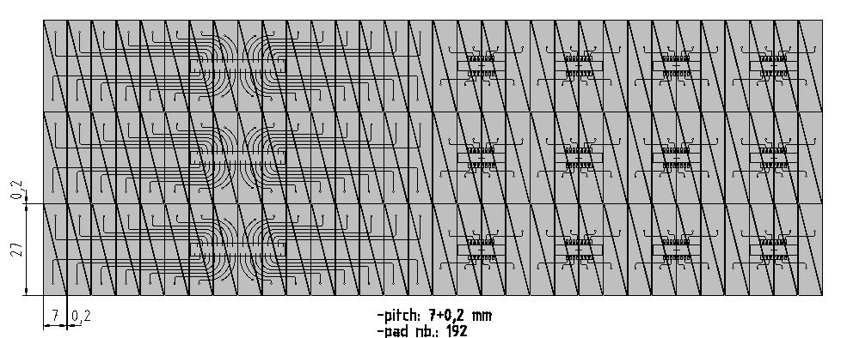
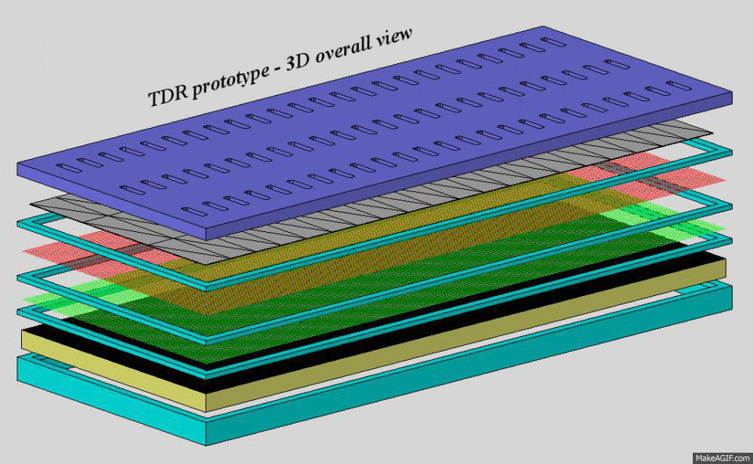
CBM-TRD prototype design
3
-single MWPC ( 2 x 4 mm amplification region) + 4 mm drift region
-4 mm anode – cathode gap
-3 mm anode wire pitch (20 µm gold plated W wires)
-1.5 mm cathode wire pitch (70 µm Cu-Be wires)
readout electrode: PCB 300 μm
triangular shape of pads
readout cell area (0.7 x 2.7)/2 ≈ 1 cm² , 192 triangular pads and total area of 8 x 69 cm²
Sequence of detector assembling
Mădălina Târzilă, 2nd EuNPC, 20th September 2012

Slide 4
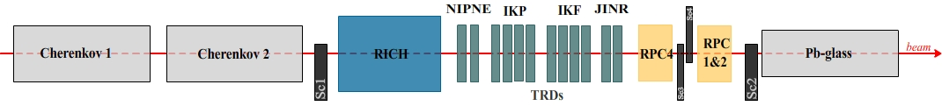
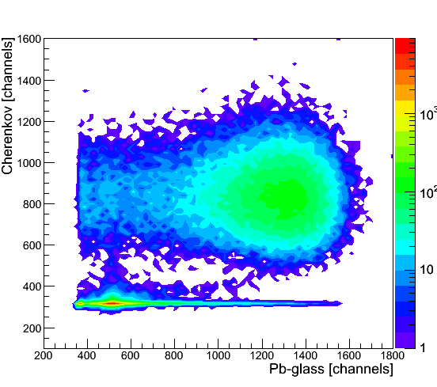
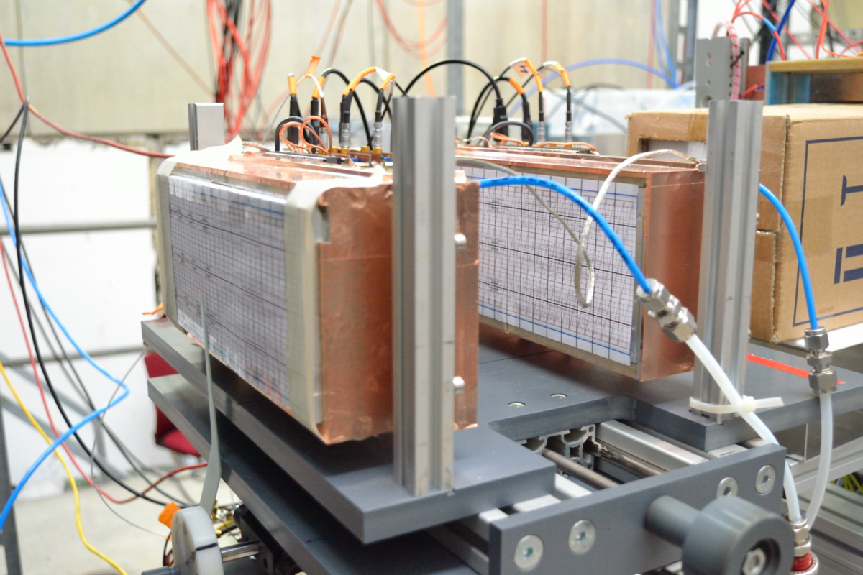
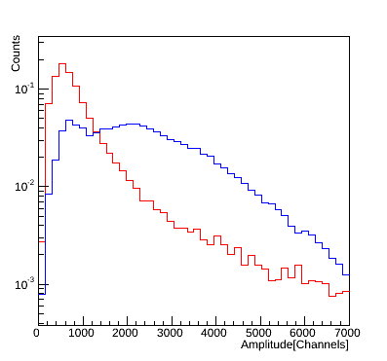
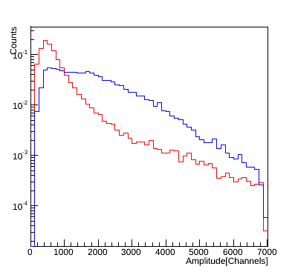
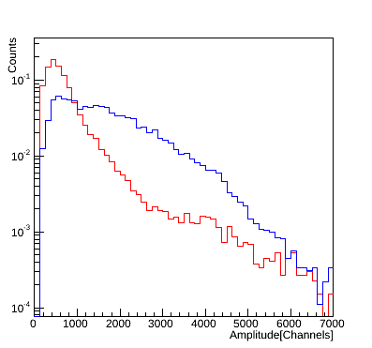
e/π discrimination
4
Test-Beam set-up @ T9 PS CERN 2011
TRD1
TRD2
regular foil radiator Reg2 (220 foils 20 μm thick, two consecutive foils are separated by a 250 μm gap) in front of TRD1
Xe-CO2(80% - 20%) gas mixture; HVa = 2000 V; HVd = 800 V
FEE : Fast Analog Signal Processor FASP-VO.1
(A. Caragheorgheopol, D. Bartos, V. Catanescu CBM Meeting, October 2009 , Split)
beam
e
π
Pulse height distribution for electrons and pions:
e
π
4 GeV/c
6 GeV/c
8 GeV/c
Mădălina Târzilă, 2nd EuNPC, 20th September 2012

Slide 5
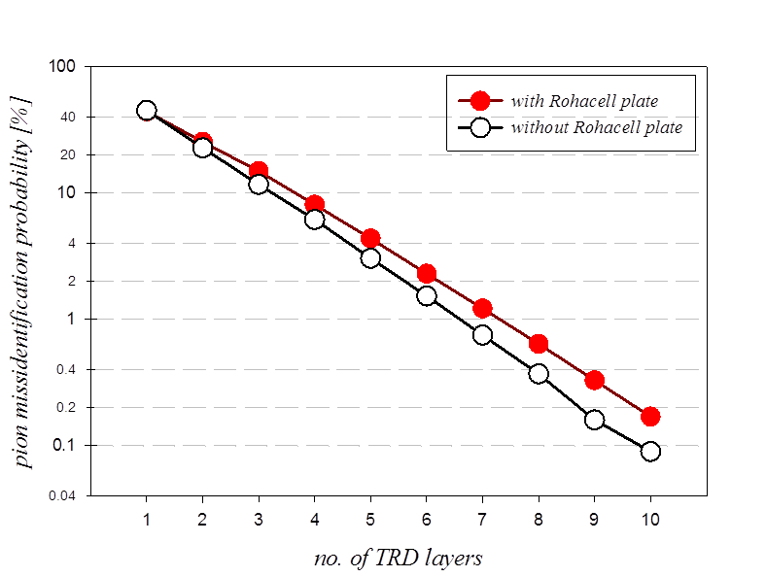
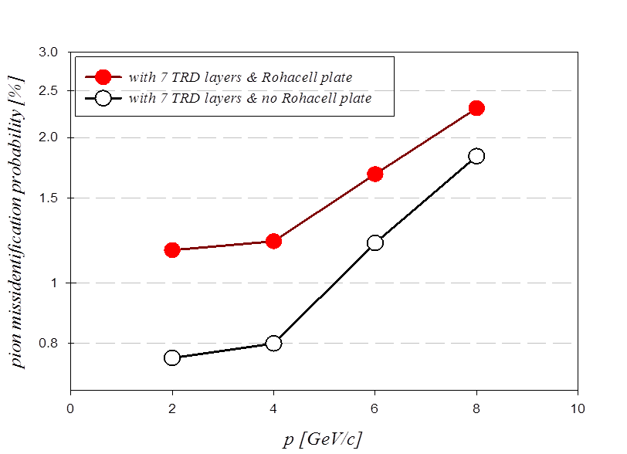
e/π discrimination – pion rejection factor
5
TRD operationg conditions:
Xe-CO2
HVa = 2000 V
HVd = 800 V
Reg 2 : 220 foils 20 μm thick (two consecutive foils are separated by a 250 μm gap)
more information on the backup slide
@ p = 4 GeV/c
pion suppression ≈1% with 7 TRD layers
Mădălina Târzilă, 2nd EuNPC, 20th September 2012

Slide 6
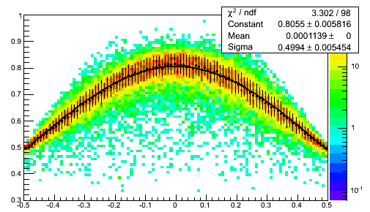
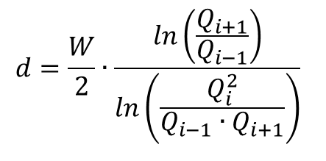

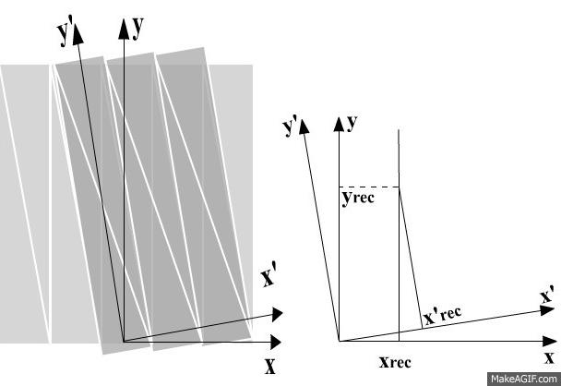
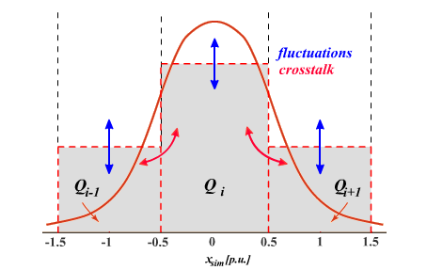
Position reconstruction – algorithm
6
PRF for TRD1
(track position relative to the center of the pad with maximum charge)
Algorithm:
1.pairing of triangular pads resulting:
a rectangular pad configuration
a tilted pad configuration
2.position across the pads is reconstructed considering clusters of 3 or 2 adjacent pads
3.position along the pads is the intersection of two lines each one parallel with the y coordinate in the systems associated with the pad configurations from above
d [p.u.]
Simplified simulations:
effects:
  1.uniform distribution for hit position
  2.Gaussian shape for the charge distribution
  3.pedestal fluctuation
  4.crosstalk between pads
Mădălina Târzilă, 2nd EuNPC, 20th September 2012

Slide 7
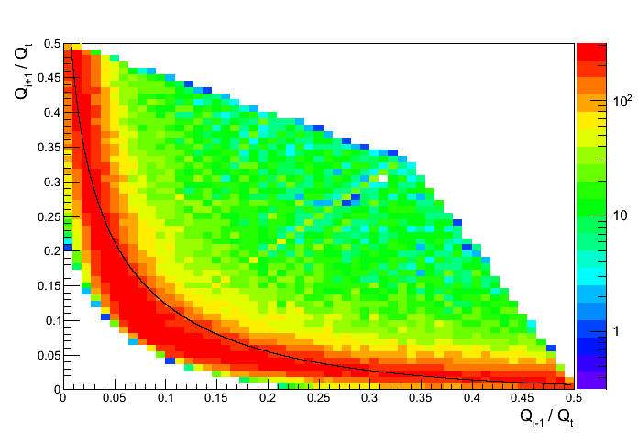
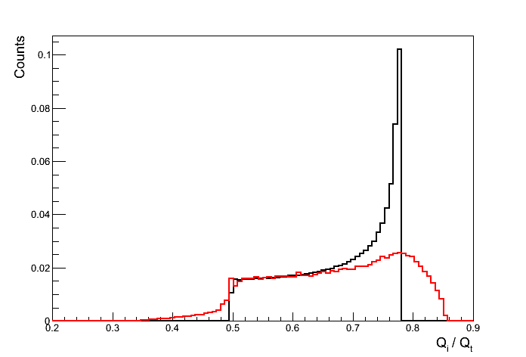
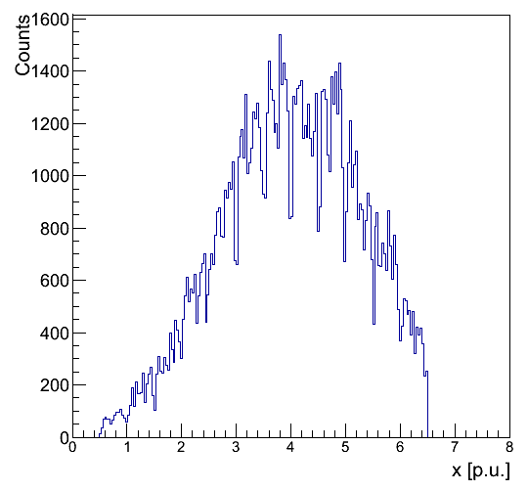
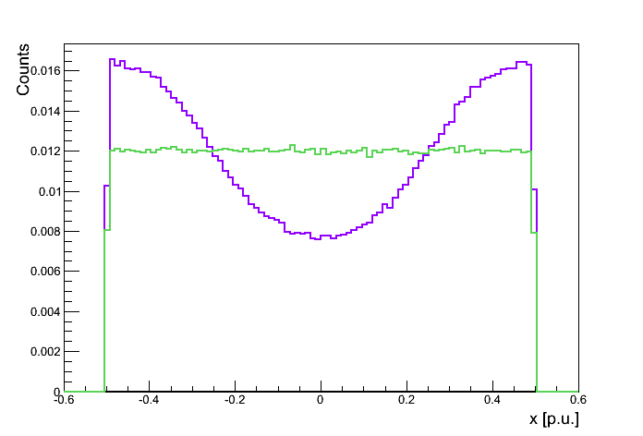
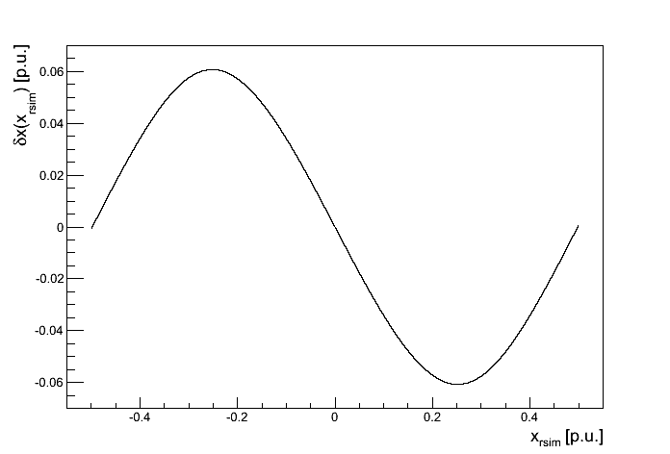


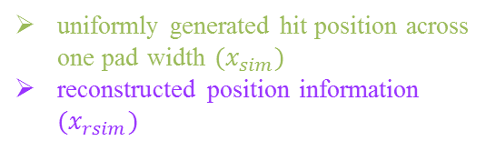
Systematic study – simulation I
7
cluster shape distributions:
simulation
-data
-simulated
uniformly generated hit position across one pad width $(x_{sim})$
reconstructed position information $(x_{rsim})$
data
$$x_{sim}$$
$$x_{rsim}$$
$$δx\left(x_{rsim}\right)$$
beam profile with applied corrections
-because the Gaussian signal is digitized on a finite interval (given by 3 pads)
systematic errors in position reconstruction
calculate corrections of digitization
Mădălina Târzilă, 2nd EuNPC, 20th September 2012

Slide 8
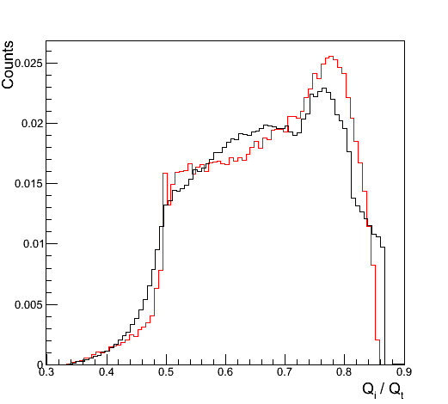

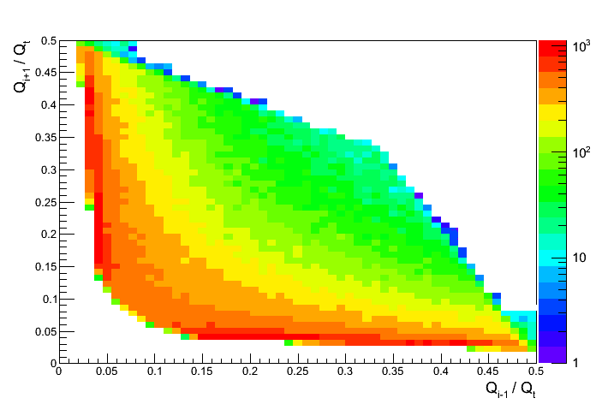
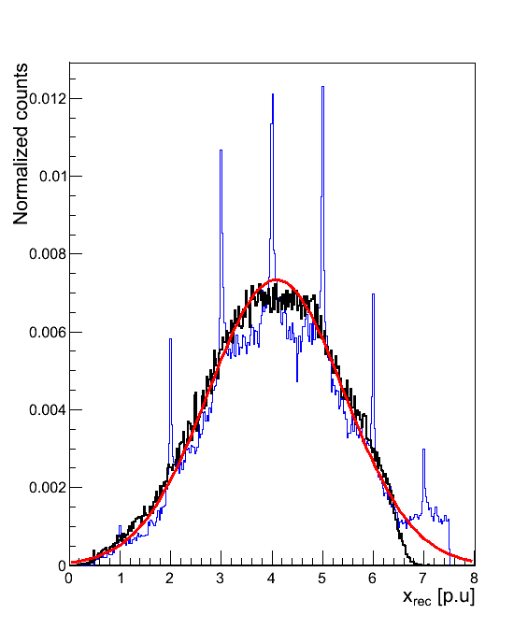
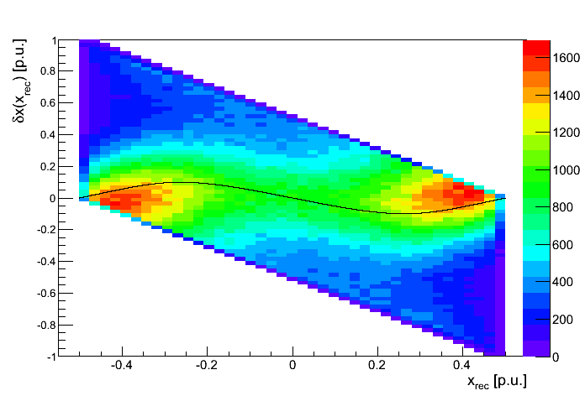


Systematic study – simulation II
8
cluster shape distributions:
data
simulation
-data
-simulated
$σ_{x_{┴}}≈550 μm$
Preliminary results!
$$δx\left(x_{rec}\right)$$
by adding fluctuations and crosstalk
spikes
missing tail due to a limited number of electronically equipped readout pads
a distribution correction
realistic beam profile
-reconstructed measurements
-reconstructed position with correction
-Gaussian fit
Mădălina Târzilă, 2nd EuNPC, 20th September 2012

Slide 9
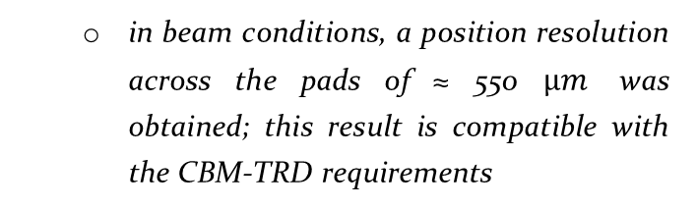
Conclusions & Outlook
9
- the results show:
  e/π discrimination of 1% for 7 TRD layers
  In progress:
  - further systematic studies including the reconstruction along the pads (the y coordinate)
- preparations towards a “real size prototype”
  - not all detector effects were taken into account in simulations
  - lack of information from a “witness” (a detector with a better position resolution)
  in beam conditions, a position resolution across the pads of ≈ 550 $μm$ was obtained; this result is compatible with the CBM-TRD requirements
despite the fact
Mădălina Târzilă, 2nd EuNPC, 19th September 2012

Slide 10
Back-up slide
10
Mădălina Târzilă, 2nd EuNPC, 19th September 2012

Slide 11
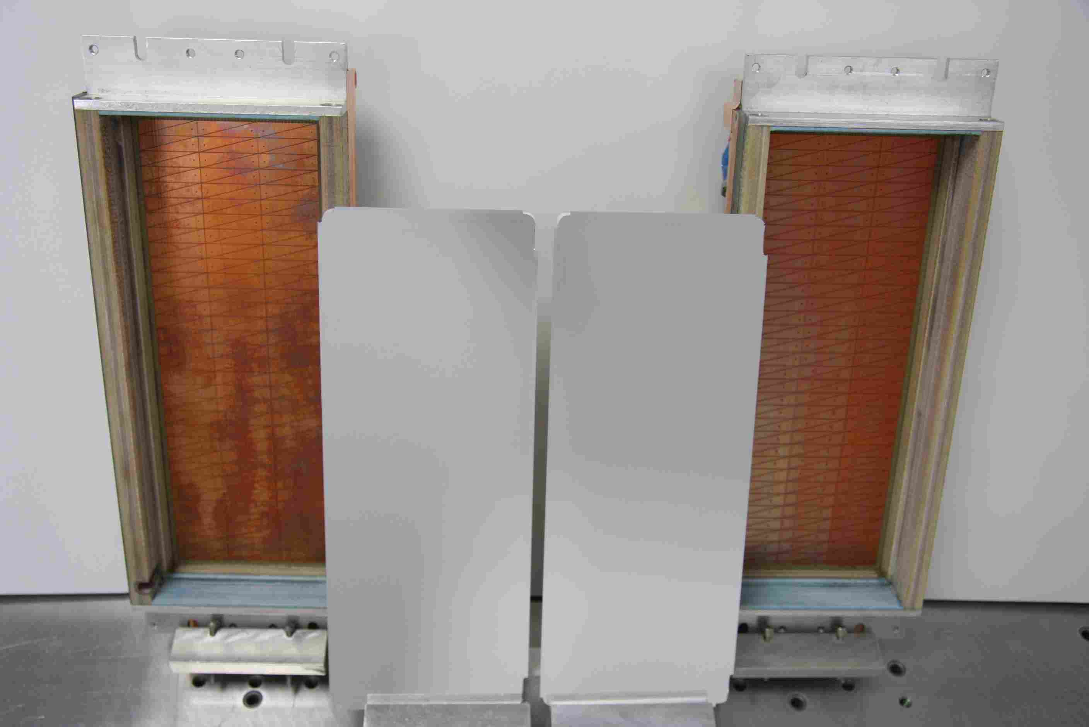
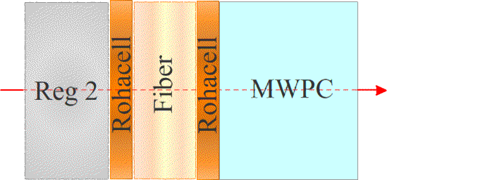
e/π discrimination – pion rejection factor
11
Rohacell plate – support for drift electrode
a Rohacell plate between the regular foil radiator and an inner fiber radiator was removed
2011 TRD (2x4+4 mm) prototype
Pad plane
electrode
Mădălina Târzilă, 2nd EuNPC, 19th September 2012

